Slide 1
Number Systems and Digital Systems

Slide 2
Decimal Number System
 Base (also called radix) = 10
◆ 10 digits { 0, 1, 2, 3, 4, 5, 6, 7, 8, 9
 Digit Position
◆ Integer & fraction
 Digit Weight
}
2
1
0
-1
-2
5
1
2
7
4
◆ Weight = (Base)
 Magnitude
Position
100
10
1
0.1
0.01
◆ Sum of “Digit x Weight”
 Formal Notation
500
10
2
0.7
0.04
2
1
0
-1
-2
d2*B +d1*B +d0*B +d-1*B +d-2*B
(512.74)₁₀

Slide 3
Octal Number System
 Base = 8
◆ 8 digits { 0, 1, 2, 3, 4, 5, 6, 7
 Weights
}
◆ Weight = (Base)
 Magnitude
Position
64
8
1
1/8 1/64
5
1
2
7
4
◆ Sum of “Digit x Weight”
 Formal Notation
2
5 *8²+1
1
0
-1
-2
*8¹+2 *8⁰+7
*8⁻¹+4 *8⁻
2
=(330.9375)10
(512.74)₈

Slide 4
Binary Number System
 Base = 2
◆ 2 digits { 0, 1 }, called binary digits or “bits”
 Weights
◆ Weight = (Base)
 Magnitude
Position
4
2
1
1/2
1/4
1
0
1
0
1
◆ Sum of “Bit x Weight”
 Formal Notation
2
1 *2²+0
1
0
-1
-2
*2¹+1 *2⁰+0
*2⁻¹+1 *2⁻
2
 Groups of bits
4 bits = Nibble
8 bits = Byte
=(5.25)10
(101.01)₂
1 0 1 1
1 1 0 0 0 1 0 1

Slide 5
Hexadecimal Number System
 Base = 16
◆ 16 digits { 0, 1, 2, 3, 4, 5, 6, 7, 8, 9, A, B,
 Weights
C, D, E, F }
◆ Weight = (Base)
 Magnitude
Position
256
16
1
1/16 1/256
1
E
5
7
A
◆ Sum of “Digit x Weight”
 Formal Notation
2
1
0
-1
-2
1 *16²+14 *16¹+5 *16⁰+7 *16⁻¹+10 *16⁻²
=(485.4765625)₁₀
(1E5.7A)₁₆

Slide 6
The
Power
of
2
n
₂n
n
₂n
0
2⁰=1
8
2⁸=256
1
2¹=2
9
2⁹=512
2
2²=4
10
2¹⁰=1024
Kilo
3
2³=8
11
2¹¹=2048
4
2⁴=16
12
2¹²=4096
5
2⁵=32
20
2²⁰=1M
Mega
6
2⁶=64
30
2³⁰=1G
Giga
7
2⁷=128
40
2⁴⁰=1T
Tera

Slide 7
Addition
 Decimal
Addition
1
1
5
5
Carry
5
5
+
1
1
0
=
Ten ≥ Base
➔ Subtract a Base

Slide 8
Binary Addition
 Column
Addition
1
1
1
1
1
1
1
1
0
1
1
1
1
0
1
1
1
=
=
61
23
+
1
0
1
0
1
0
0
=
84
≥ (2)10

Slide 9
Binary Subtraction
 Borrow
a
“Base” when needed
1
2
0
2
0
1
1
= (10)2
0
1
2
0
1
0
1
0
2
0
1
1
1
=
=
77
23
−
0
1
1
0
1
1
0
=
54

Slide 10
Binary
Multiplication
 Bit
by
bit
1
0
1
1
0
1
1
1
0
x
0
0
0
1
0
1
0
1
0
1
0
0
1
0
1
0
1
0
0
1
1
1
1
0
0
1
1
0

Slide 11
Number Base Conversions
Evaluate
Magnitude
Octal
(Base
8)
Evaluate
Magnitude
Decimal
Binary
(Base 2)
(Base
10)
Hexadecimal
(Base 16)
Evaluate
Magnitude

Slide 12


Decimal (Integer) to Binary Conversion
 Divide the number by the ‘Base’ (=2)
 Take the remainder (either 0
 Take the quotient and repeat
or 1) as a coefficient
the division
Example: (13)10
Quotient
6
3
1
0
Remainder
1
0
1
1
Coefficient
a₀ = 1
a₁ = 0
a₂ = 1
a₃ = 1
13 / 2 =
6 / 2 =
3 / 2 =
1 / 2 =
Answer:
(13)10 = (a3 a2 a1 a0)2 = (1101)2
MSB
LSB

Slide 13

Decimal (Fraction) to Binary Conversion
 Multiply the number by the ‘Base’ (=2)
 Take the integer (either 0 or 1) as a coefficient
 Take the resultant fraction and repeat the
division
Example: (0.625)10
Integer Fraction
Coefficient
0.625 * 2 = 1
0.25 * 2 = 0
.
.
.
25
5
0
ª-1
ª-2
ª-3
= 1
= 0
= 1
0.5
* 2 = 1
Answer:
(0.625)10 = (0.a-1 a-2 a-3)2 = (0.101)2
MSB
LSB

Slide 14
Decimal to Octal Conversion
Example: (175)₁₀
Quotient
21
2
0
Remainder
7
5
2
Coefficient
a₀ = 7 a₁ = 5 a₂ = 2
175 / 8 =
21 / 8 =
2
/ 8 =
Answer:
(175)10 = (a2 a1 a0)8 = (257)8
Example: (0.3125)10
Integer Fraction
Coefficient
0.3125 * 8 = 2
.
.
5
0
a-1
a-2
= 2
= 4
0.5
* 8 = 4
Answer:
(0.3125)10 = (0.a-1 a-2 a-3)8 = (0.24)8

Slide 15
Binary − Octal
Conversion
Octal
Binary
 8 =
2³
0
0 0 0
 Each group
digit
of
3 bits represents an
octal
1
0 0 1
2
0 1 0
Example:
Assume Zeros
3
0 1 1
(
1 0 1 1 0
. 0 1
)2
4
1 0 0
5
1 0 1
6
1 1 0
(
2
6
. 2
)8
7
1 1 1
Works both
ways (Binary
to Octal &
Octal
to Binary)

Slide 16
Binary − Hexadecimal
Conversion
Hex
Binary
 16 =
2⁴
0
0 0 0 0
 Each group of 4 bits represents a
1
0 0 0 1
2
0 0 1 0
hexadecimal
digit
3
0 0 1 1
4
0 1 0 0
5
0 1 0 1
Example:
Assume Zeros
6
0 1 1 0
7
0 1 1 1
( 1 0 1 1 0
. 0 1
)2
8
1 0 0 0
9
1 0 0 1
A
1 0 1 0
B
1 0 1 1
C
1 1 0 0
D
1 1 0 1
( 1
6
. 4
)16
& Hex
E
1 1 1 0
F
1 1 1 1
Works both
ways (Binary
to Hex
to Binary)

Slide 17
Octal − Hexadecimal Conversion
 Convert to Binary
Example:
(
as an
intermediate step
2
6
.
2
)8
Assume
Zeros
Assume
Zeros
( 0
1 0
1 1
0 .
0 1
0 )2
( 1
6
.
4
)16
Works both ways (Octal to Hex & Hex
to Octal)

Slide 18
Decimal, Binary, Octal and Hexadecimal
Decimal
Binary
Octal
Hex
00
0000
00
0
01
0001
01
1
02
0010
02
2
03
0011
03
3
04
0100
04
4
05
0101
05
5
06
0110
06
6
07
0111
07
7
08
1000
10
8
09
1001
11
9
10
1010
12
A
11
1011
13
B
12
1100
14
C
13
1101
15
D
14
1110
16
E
15
1111
17
F

Slide 19
Complements
 There are two types of complements for each base-r system: the radix complement and
diminished radix complement.
 Diminished Radix Complement - (r-1)’s Complement
◆ Given a number N in base r having n digits, the (r–1)’s complement
defined as:
(r^{n} –1) – N
 Example for 6-digit decimal numbers:
◆ 9’s complement is (r^{n} – 1)–N = (10⁶–1)–N = 999999–N
◆ 9’s complement of 546700 is 999999–546700 = 453299
 Example for 7-digit binary numbers:
◆ 1’s complement is (r^{n} – 1) – N = (2⁷–1)–N = 1111111–N
◆ 1’s complement of 1011000 is 1111111–1011000 = 0100111
 Observation:
◆ Subtraction from (r^{n} – 1) will never require a borrow
◆ Diminished radix complement can be computed digit-by-digit
◆ For binary: 1 – 0 = 1 and 1 – 1 = 0
of N
is

Slide 20
Complements
 1’s Complement (Diminished Radix Complement)
◆ All ‘0’s become ‘1’s
◆ All ‘1’s become ‘0’s
Example (10110000)₂
⇨ (01001111)₂
If you
add a
number and its 1’s complement …
1
0
0
1
1
0
1
0
0
1
0
1
0
1
0
1
+
1
1
1
1
1
1
1
1

Slide 21
Complements
 Radix Complement
The r's complement of an n-digit number N in base r is defined as r^{n} – N for N ≠ 0 and as 0 for N = 0. Comparing with the (r − 1) 's complement, we note that the r's complement is obtained by adding 1 to the (r − 1) 's complement, since r^{n} – N = [(r^{n} − 1) – N] + 1.
 Example: Base-10
The 10's complement of 012398 is 987602
The 10's complement of 246700 is 753300
 Example: Base-2
The 2's complement of 1101100 is 0010100
The 2's complement of 0110111 is 1001001

Slide 22
Complements
 2’s Complement (Radix Complement)
◆ Take 1’s complement then add 1
OR
◆ Toggle all bits to the left of the first ‘1’ from the right
Example:
Number:
1’s Comp.:
1
0
0
1
1
0
1
0
0
1
0
1
0
1
0
1
1
1 0 1
1 0 0 0 0
+
0
1
0
1
0
0
0
0
0 1 0
1 0 0 0 0

Slide 23
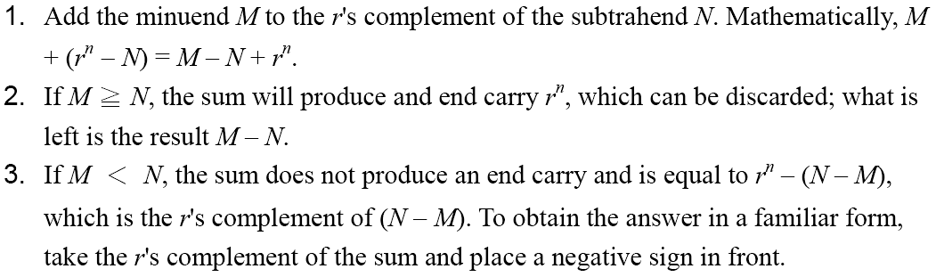
Complements
 Subtraction with Complements
◆ The subtraction of two n-digit unsigned numbers M – N in base r can be done as follows:

Slide 24
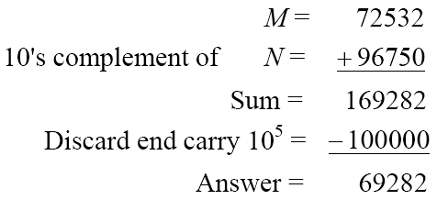
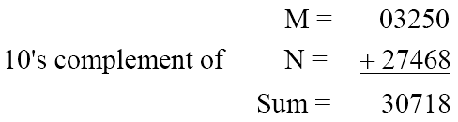
Complements
 Example 1.5
◆ Using 10's complement, subtract 72532 – 3250.
 Example 1.6
◆ Using 10's complement, subtract 3250 – 72532.
There is no end carry.
Therefore, the answer is – (10's complement of 30718) = − 69282.

Slide 25
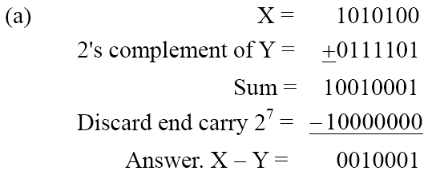
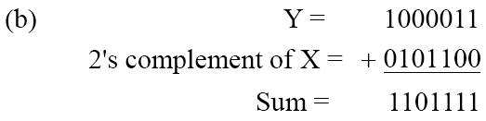
Complements
 Example 1.7
◆ Given the two binary numbers X = 1010100 and Y = 1000011, perform the subtraction (a) X – Y ; and (b) Y − X, by using 2's complement.
There is no end carry.
Therefore, the answer is
Y – X = − (2's complement of 1101111) = − 0010001.

Slide 26
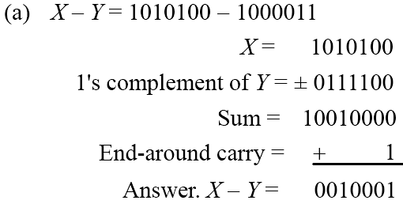
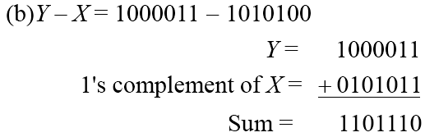
Complements
 Subtraction of unsigned numbers can also be done by means of the (r − 1)'s
complement. Remember that the (r − 1) 's complement is one less then the r's complement.
 Example 1.8
◆ Repeat Example 1.7, but this time using 1's complement.
There is no end carry, Therefore, the answer is Y – X = − (1's complement of
1101110) = − 0010001.

Slide 27
Data Representation
The ways to represent the data are:
 Unsigned Representation
Signed Representation
- Signed magnitude representation
- Signed 1’s complement representation
- Signed 2’s complement Representation

Slide 28
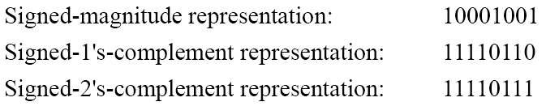
1.6
Signed Binary Numbers
 To represent negative integers, we need a notation for negative
values.
 It is customary to represent the sign with a bit placed in the leftmost position of the number since binary digits.
 The convention
negative.
 Example:
is
to
make
the
sign
bit
0
for
positive
and
1
for

Slide 29
Weighted and Non weighted Code
Weighted Code:-
In weighted code, each digit position has a weight or value. The sum of all digits multiplied by a weight gives the total amount being represented.
We can express any decimal number in tens, hundreds, thousands and so on.
Eg:- Decimal number 4327 can be written as
4327= 4000+300+20+7
In the power of 10, it becomes
4327= 4(10³)+3(10²)+2(10¹)+7(100)
BCD or 8421 is a type of weighted code where each digit position is being assigned a specific weight.
Non-weighted code:-
In non-weighted code, there is no positional weight i.e. each position within the binary number is not assigned a prefixed value. No specific weights are assigned to bit position in non –weighted code.
The non-weighted codes are:-
a) The Gray code b) The Excess-3 code

Slide 30
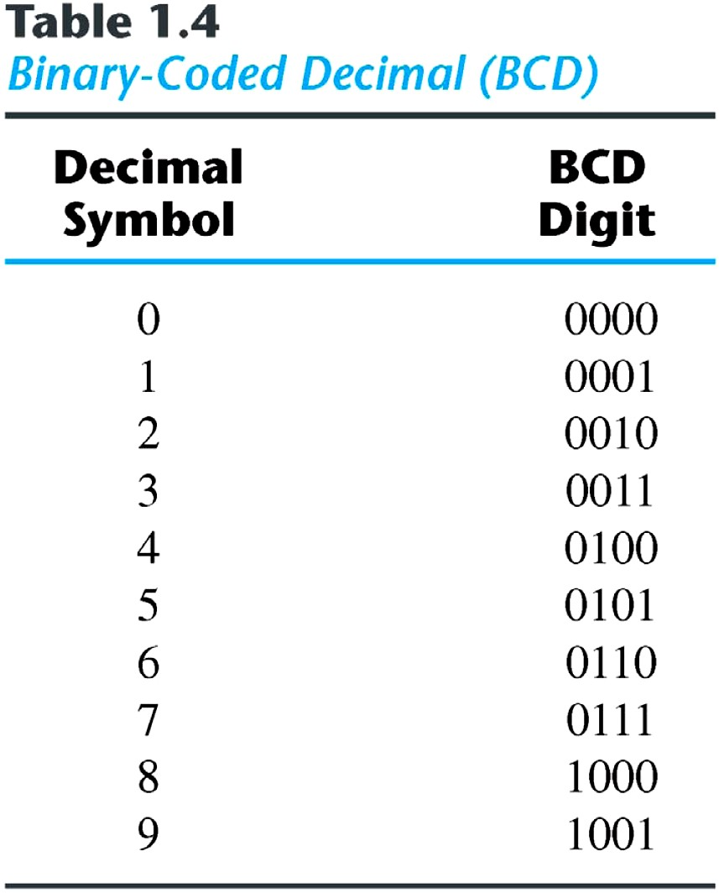
Binary
Codes
BCD or 8421 code:-
It is composed of four bits representing the decimal digits 0 through 9.
The 8421 indicates the binary weights of the four bits(2³,2²,2¹,20).
A number with k decimal digits will
require 4k bits in BCD.
Decimal 396 is represented in BCD with 12bits as 0011 1001 0110, with each group of 4 bits representing one decimal digit.
A decimal number in BCD is the same as its equivalent binary number only when the number is between 0 and 9.
The binary combinations 1010 through 1111 are not used and have no meaning in BCD.

Slide 31
BCD or 8421 Code
Convert following to BCD form
a)47310 b) 31210 c) 25710 d) 11210
Convert following BCD to their decimal equivalent
a)10000110 b) 00110010.10010100
Convert the following binary number numbers to their BCD equivalent.
a)1101.012 b) 11.0112
(Binary to decimal Decimal to BCD)

Slide 32
Comparison of BCD with Binary
1. BCD is less efficient than binary
eg:- (78)10 = (0111 1000)BCD
=(1001110)2
To encode the same decimal number , BCD needs more no. of bits than binary . Hence BCD is less efficient as compared to Binary
2. BCD arithmetic is more complicated than binary arithmetic.
3. Advantage of a BCD code is that the conversion from decimal to BCD or vice versa is simple.

Slide 33
BCD or 8421 Code
Decimal | BCD
weight | 8 4 2 1
0 | 0 0 0 0
1 | 0 0 0 1
2 | 0 0 1 0
3 | 0 0 1 1
4 | 0 1 0 0
5 | 0 1 0 1
6 | 0 1 1 0
7 | 0 1 1 1
8 | 1 0 0 0
9 | 1 0 0 1
Unused or Don’t care conditions
1010
1011
1100
1101
1110
1111

Slide 34
Comparison of BCD with Binary
1. BCD is less efficient than binary
eg:- (78)10 = (0111 1000)BCD
=(1001110)2
To encode the same decimal number , BCD needs more no. of bits than binary . Hence BCD is less efficient as compared to Binary
2. BCD arithmetic is more complicated than binary arithmetic.
3. Advantage of a BCD code is that the conversion from decimal to BCD or vice versa is simple.

Slide 35
8 4 -2 -1 Code
Decimal | 84-2-1 code
weight | 8 4 -2 -1
0 | 0 0 0 0
1 | 0 1 1 1
2 | 0 1 1 0
3 | 0 1 0 1
4 | 0 1 0 0
5 | 1 0 1 1
6 | 1 0 1 0
7 | 1 0 0 1
8 | 1 0 0 0
9 | 1 1 1 1
Unused or Don’t care conditions
0001
0010
0011
1100
1101
1110

Slide 36
2421 Code
Decimal | 2421 Code
weight | 2 4 2 1
0 | 0 0 0 0
1 | 0 0 0 1
2 | 0 0 1 0
3 | 0 0 1 1
4 | 0 1 0 0
5 | 1 0 1 1
6 | 1 1 0 0
7 | 1 1 0 1
8 | 1 1 1 0
9 | 1 1 1 1
Unused or Don’t care conditions
0101
0110
0111
1000
1001
1010

Slide 37
Excess-3 Code
Decimal | Excess-3 code
0 | 0 0 1 1
1 | 0 1 0 0
2 | 0 1 0 1
3 | 0 1 1 0
4 | 0 1 1 1
5 | 1 0 0 0
6 | 1 0 0 1
7 | 1 0 1 0
8 | 1 0 1 1
9 | 1 1 0 0
Unused or Don’t care conditions
0000
0001
0010
1101
1110
1111

Slide 38
Decimal | BCD | Excess-3 | 8 4 -2 -1 | 2 4 2 1
0 | 0 0 0 0 | 0 0 1 1 | 0 0 0 0 | 0 0 0 0
1 | 0 0 0 1 | 0 1 0 0 | 0 1 1 1 | 0 0 0 1
2 | 0 0 1 0 | 0 1 0 1 | 0 1 1 0 | 0 0 1 0
3 | 0 0 1 1 | 0 1 1 0 | 0 1 0 1 | 0 0 1 1
4 | 0 1 0 0 | 0 1 1 1 | 0 1 0 0 | 0 1 0 0
5 | 0 1 0 1 | 1 0 0 0 | 1 0 1 1 | 1 0 1 1
6 | 0 1 1 0 | 1 0 0 1 | 1 0 1 0 | 1 1 0 0
7 | 0 1 1 1 | 1 0 1 0 | 1 0 0 1 | 1 1 0 1
8 | 1 0 0 0 | 1 0 1 1 | 1 0 0 0 | 1 1 1 0
9 | 1 0 0 1 | 1 1 0 0 | 1 1 1 1 | 1 1 1 1

Slide 39
The Gray code
Introduction:
It is non weighted code in which each number differs from previous number by a single bit.
or
Only one bit is changed as we move from one number to another successive number.
CD
00
01
11
10
AB
0
1
2
3
00
7
6
5
4
01
8
9
10
11
11
15
14
13
12
10

Slide 40
Dec. | Binary | Gray
0 | 0 0 0 0 | 0 0 0 0
1 | 0 0 0 1 | 0 0 0 1
2 | 0 0 1 0 | 0 0 1 1
3 | 0 0 1 1 | 0 0 1 0
4 | 0 1 0 0 | 0 1 1 0
5 | 0 1 0 1 | 0 1 1 1
6 | 0 1 1 0 | 0 1 0 1
7 | 0 1 1 1 | 0 1 0 0
8 | 1 0 0 0 | 1 1 0 0
9 | 1 0 0 1 | 1 1 0 1
10 | 1 0 1 0 | 1 1 1 1
11 | 1 0 1 1 | 1 1 1 0
12 | 1 1 0 0 | 1 0 1 0
13 | 1 1 0 1 | 1 0 1 1
Dec. | Binary | Gray
14 | 1 1 1 0 | 1 0 0 1
15 | 1 1 1 1 | 1 0 0 0

Slide 41
The Excess-3 code
It is an important BCD code , is a 4 bit code and used with BCD numbers
To convert any decimal numbers into its excess-3 form ,add 3 to each decimal digit and then convert the sum to a BCD number
As weights are not assigned, it is a kind of non weighted codes.
Convert the following into Excess-3 number
a)149 b) 2546 c) 152 d) 2694
Add the following numbers in excess-3 code
a) 108+789 b) 275+496

Slide 42
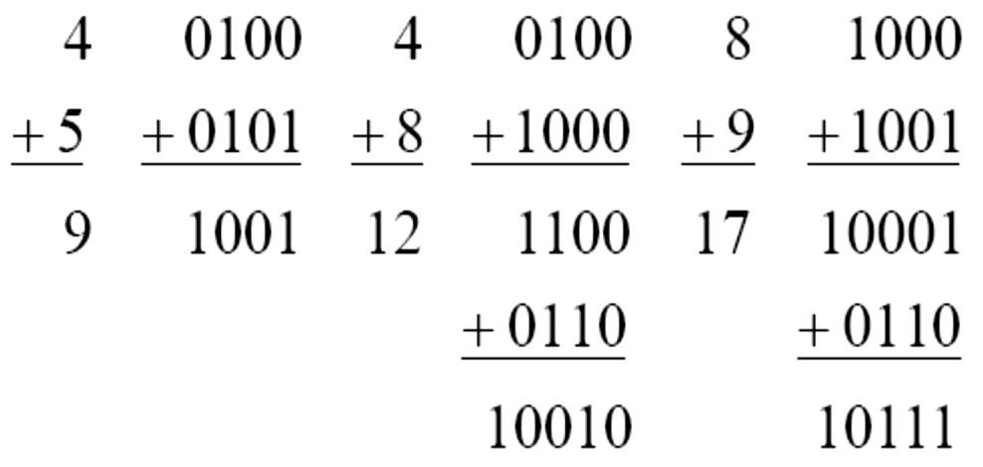
BCD addition
Add two numbers as same as binary addition
Case 1: If the result is less than or equals to 9 and carry is zero then it is valid BCD.
Case 2: If result is greater than 9 and carry is zero then add 6 in four bit combination.
Case 3: If result is less than or equals to 9 but carry is 1 then add 6 in four bit combination.

Slide 43
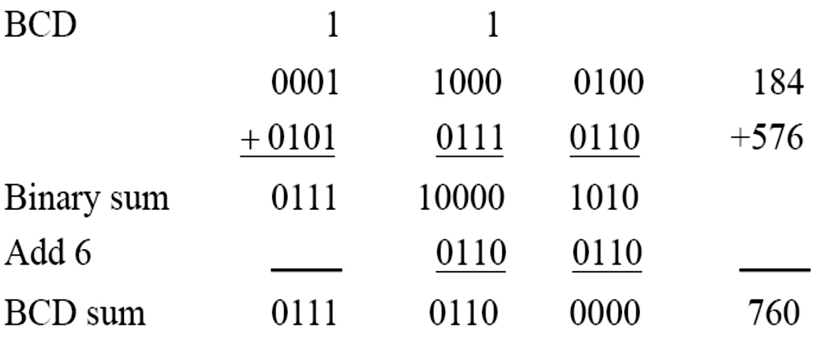
BCD Addition
 Example:
◆ Consider the addition of 184 + 576 = 760 in BCD:

Slide 44
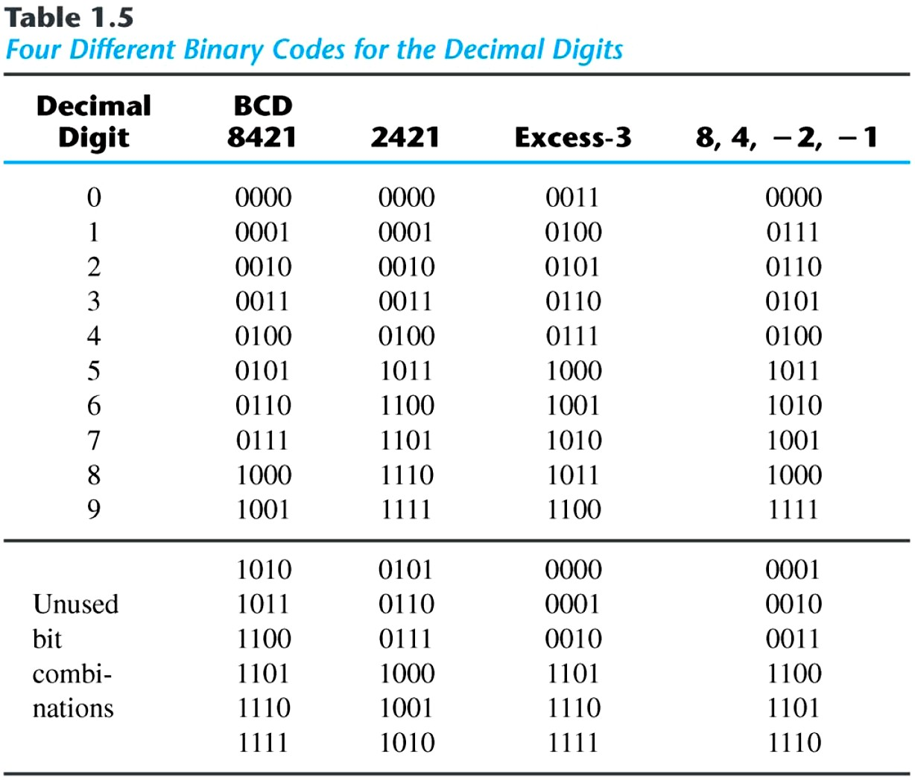
Binary Codes
 Other Decimal Codes

Slide 45
Error-Detection code
Introduction:
Electric wires or other communication medium can transmit binary information from one location to another. Any external noise introduced into the physical communication medium may change some of the bits from 0 to 1 or vice versa. The purpose of an error-detection code is to detect such bit-reversal errors. One of the most common ways to achieve error detection is by means of a parity bit. A parity bit is the extra bit included to make the total number of 1's in the resulting code word either even or odd.
Even Parity : Here the total number of 1’s in the message is made even
Odd Parity : Here the total number of 1’s in the message is made odd

Slide 46
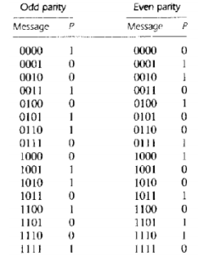
A message of 4-bits and a parity bit P are shown in the table below:

Slide 47
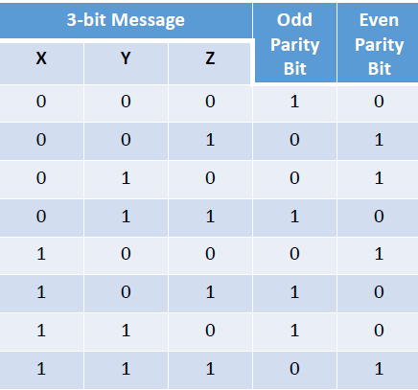
A message of 3-bits and a parity bit P are shown in the table below:

Slide 48
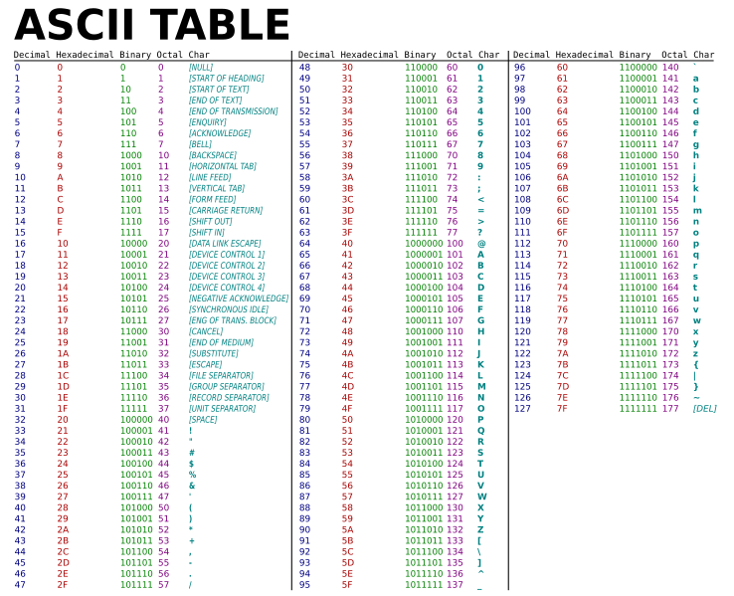
Alpha-Numeric Codes
1. American Standard Code for Information Interchange (ASCII) Character Code

Slide 49
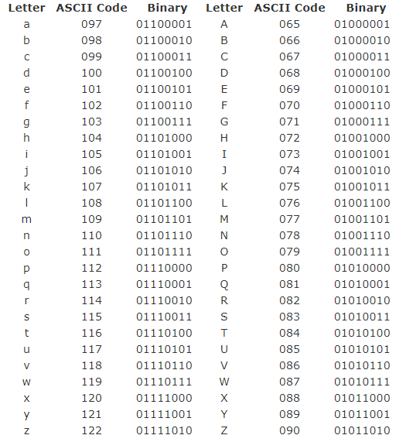
ASCII

Slide 50
ASCII Character Codes
American Standard Code for Information Interchange.
A popular code used to represent information sent as character- based data.
It uses 7-bits to represent.
ASCII uses a linear ordering of letters.
ASCII has a maximum of 128 characters.

Slide 51
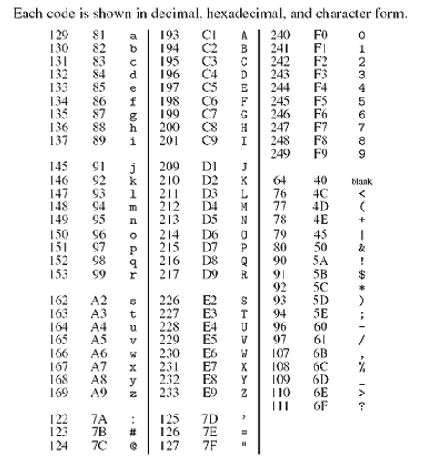
Alpha-Numeric Codes
2. Extended Binary Coded Decimal Interchange Code(EBCDIC)
It uses 8-bits to represent.
It does not use a linear ordering
of letters.
It has a maximum of 256 characters.

Slide 52
Digital Systems
 Digital age and information age
 Digital computers
◆ General purposes
◆ Many scientific, industrial and commercial applications
 Digital systems
◆ Telephone switching exchanges
◆ Digital camera
◆ Electronic calculators,
◆ Digital TV

Slide 53
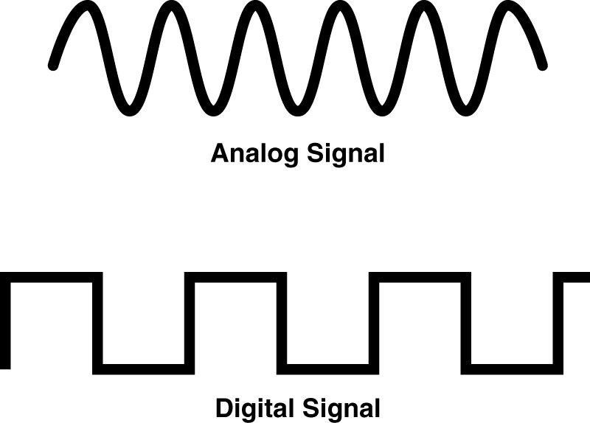
Analog and Digital Signal
 Analog system
◆ The physical quantities or range.
 Digital system
◆ The physical quantities or
signals may vary continuously over a specified
signals can assume only discrete values.

Slide 54
Logic Gates and Boolean Algebra

Slide 55
What are Gates?
•
The building blocks that creates digital circuits are logic gates.
Each gate has its own logic symbol which allows complex functions to be represented by a logic diagram
The function of each gate can be represented by a truth table or using Boolean notation
•
•

Slide 56
LOGIC GATES
Types of gates
NOT
AND
OR
NAND
NOR
EX-OR
EX-NOR
BUFFER GATE

Slide 57
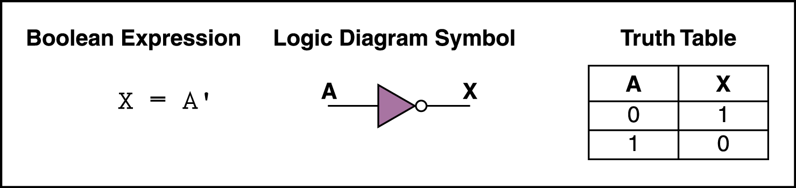
NOT Gate
•
A NOT gate accepts one input value and produces one output value
By definition, if the input value for a NOT gate is 0, the output value is 1, and if the input value is 1, the output is 0
A NOT gate is sometimes referred to as an inverter
because it inverts the input value
•
•

Slide 58
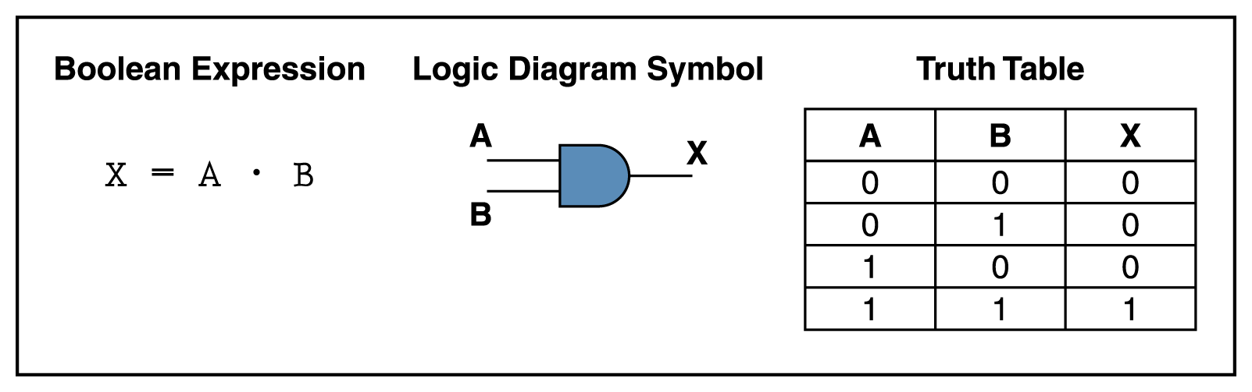
AND Gate
An AND gate accepts two input signals
If the two input values for an AND gate are both 1, the output is 1; otherwise, the output is 0

Slide 59
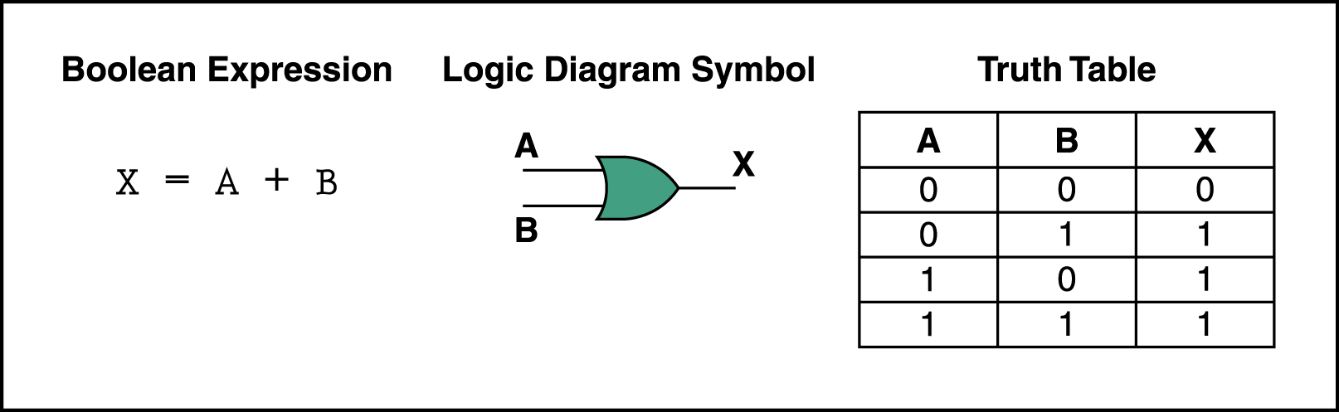
OR Gate
If the two input values are both 0, the output value is 0; otherwise, the output is 1

Slide 60
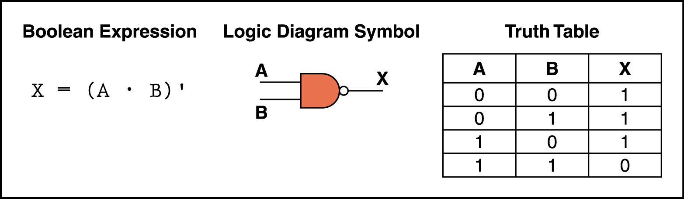
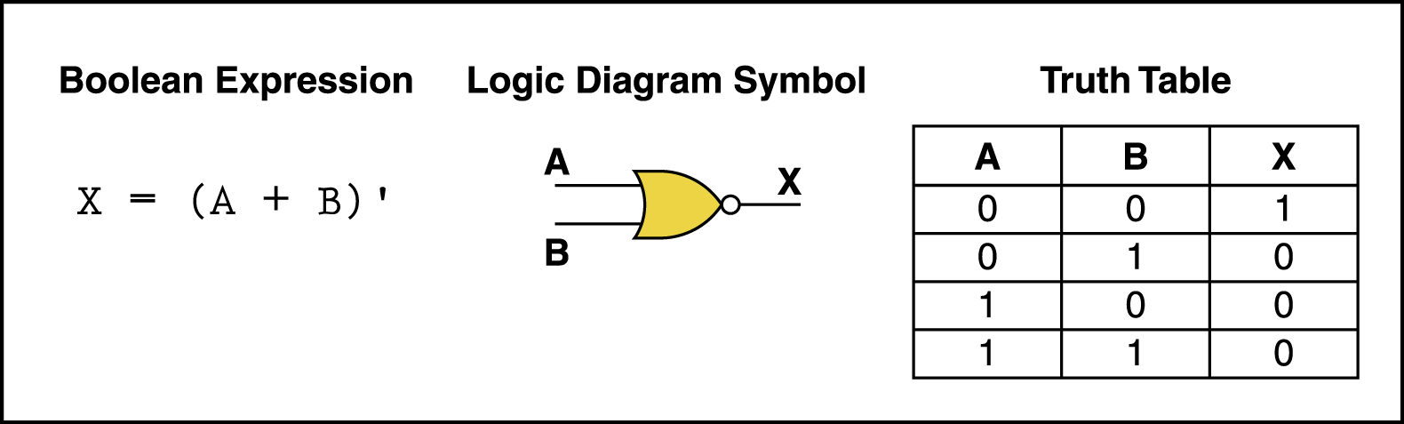
NAND and NOR Gates
The NAND and NOR gates are essentially the opposite of the AND and OR gates, respectively.
They are also called universal gates.

Slide 61
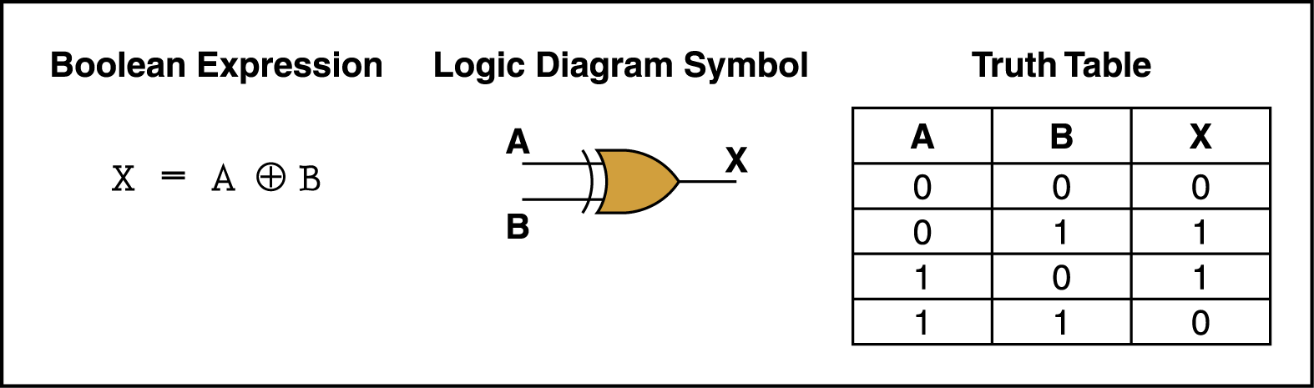
XOR Gate
XOR, or exclusive OR, gate
– An XOR gate produces 0 if its two inputs are the same, and a 1 otherwise

Slide 62
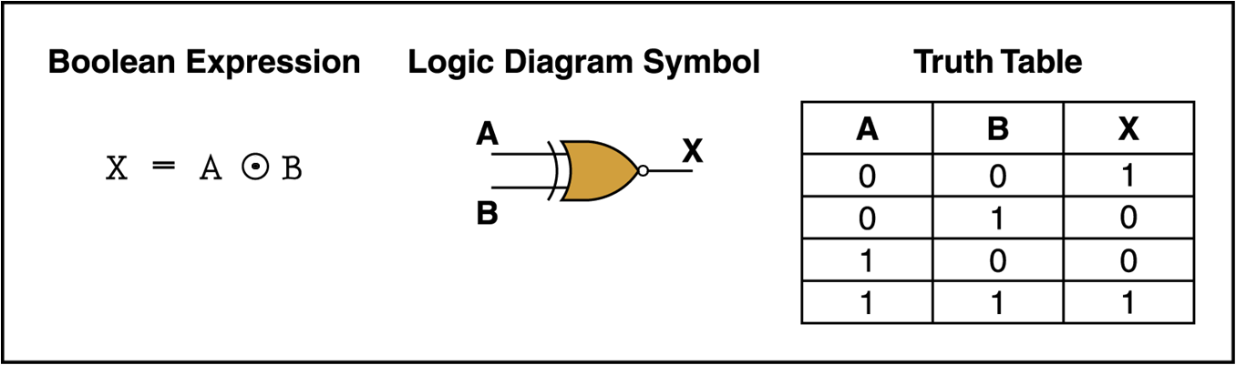
XNOR Gate
XNOR, or exclusive NOR, gate
– An XNOR gate produces 0 if its two inputs are the different, and a 1 otherwise

Slide 63
Boolean Algebra
Mathematical system, formulate logic with symbols.
Mathematics of digital system.
Algebraic Manipulation
Boolean Function
Expression using binary operators.
Bracket, NOT, AND, OR
Eg; F =x.y’.z

Slide 64
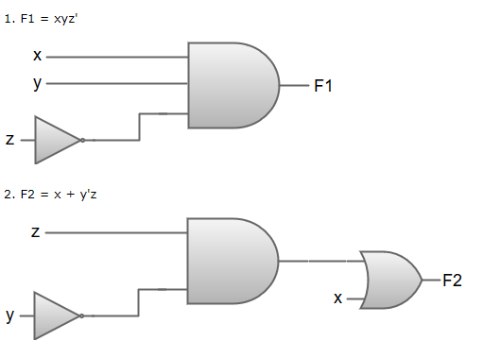
Boolean algebra simplifications using logic gates

Slide 65
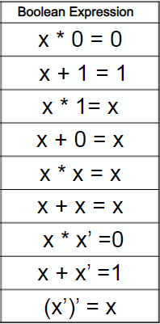
Theorems

Slide 66
Theorems
Commutative Law
It that the interchanging of the order of operands in a Boolean equation
does not change its result. For example:
OR operator → A + B = B + A
AND operator → A . B = B . A
Associative Law
It states that the AND operation are done on two or more than two variables.
For example:
A .(B.C) = (A.B).C A+(B+C) = (A+B)+C
Distributive Law
It states that the multiplication of two variables and adding the result with a
variable will result in the same value as multiplication of addition of the variable
with individual variables. For example:
A + BC = (A + B) (A + C) and A .(B+C) = AB+ AC

Slide 67
Theorems
De Morgan's Theorem
(A+B)’ = A’.B’ (A+B+C)’ = A’.B’.C’
(A.B)’ = A’+B’ (A.B.C)’ = A’+B’+C’
Duality Principle:
To find the dual of any expression:
- change the operator
- 0 > 1, 1>0
Eg: a+a’= 1 dual : a.a’=0
How to find complement?
- find dual
- complement each variable.
Eg: F= x+y 1.dual = x.y 2. F’= x’.y’

Slide 68
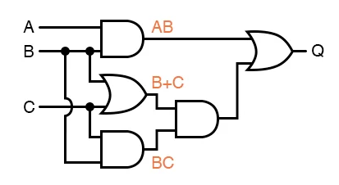
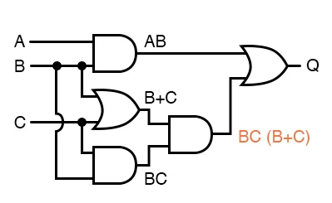
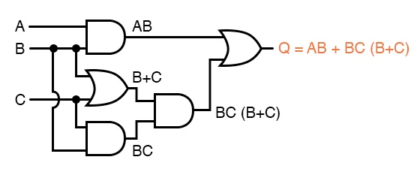
Gate Implementation
Q=A.B+B.C.(B+C)

Slide 69
Simplification of Boolean Functions
Simplify the following Boolean functions to a minimum number of literals.
x+x’.y = (x+x’).(x+y) = 1.(x+y) = (x+y)
x(x’+y) = x.x’ + xy = 0+xy = xy
x’y’z + x’yz +xy’ = x’z(y+y’) + xy’ = x’z+xy’
xy + x’z +yz = xy+yz +x’z +x.x’ = y(x+z)+x’(x+z) = (x+z)(y+x’)
(x+y)(x’+z)(y+z)

Slide 70
Find the complement of F = x+y’z. Also prove F.F’= 0 and F+F’= 1. Implement F = xy+x’y’+yz’
using AND,OR and NOT gates
using NOT and OR only
using NOT and AND only

Slide 71
Q= A’B’+A’C+B’C’
Q= A’C+B’C’
Redundant Theorem:
3 variables
Each variable repeated twice
One variable must be complemented
Take complemented variable and remaining is redundant.
F = AB+BC’+AC = BC’+AC
F =(A+B).(A’+C).(B+C) = A+B).(A’+C)

Slide 72
Find the complement of F = x+y’z. Also prove F.F’= 0 and F+F’= 1. F’ = (x+y’z)’ = x’.(y’.z)’ = x’.(y+z’) = x’y+x’z’ To prove: F.F’=0 LHS. (X+y’z). (x’y+x’z’ ) To prove: F+F’=1 LHS. X+y’z+x’y+x’z’ = x+x’y+y’z+x’z’ = X+y+y’z+x’z’ = x+x’z’+y+y’z = A+ 1 =1 F+F’ = [(F+F’)’]’ = [(F’.F)]’ = [0]’ = 1

Slide 73
Canonical and Standard Forms
Boolean functions expressed as a sum of minterms or product of maxterms are said to be in canonical.
Minterms and Maxterms
Sum-of-Minterms and Product-of- Maxterms
Product and Sum terms
Sum-of-Products (SOP) and Product-of-Sums (POS)
No of minterms = no of maxterms = 2^{n}

Slide 74
Definitions
Literal: A variable or its complement
Product term: literals connected by •
Sum term: literals connected by +
Minterm: a product term in which all the variables appear exactly once, either complemented or uncomplemented
Maxterm: a sum term in which all the variables appear exactly once, either complemented or uncomplemented

Slide 75
Minterm
Represents exactly one combination in the truth table.
Denoted by m_{j}, where j is the decimal equivalent of the minterm’s corresponding binary combination (b_{j}).
A variable in m_{j} is complemented if its value in b_{j} is 0, otherwise is uncomplemented.
Example: Assume 3 variables (A,B,C), and j=3. Then, b_{j} = 011 and its corresponding minterm is denoted by m_{j} = A’BC

Slide 76
Maxterm
Represents exactly one combination in the truth table.
Denoted by M_{j}, where j is the decimal equivalent of the maxterm’s corresponding binary combination (b_{j}).
A variable in M_{j} is complemented if its value in b_{j} is 1, otherwise is uncomplemented.
Example: Assume 3 variables (A,B,C), and j=3. Then, b_{j} = 011 and its corresponding maxterm is denoted by M_{j} = A+B’+C’

Slide 77
Truth Table notation for Minterms and Maxterms
Minterms and Maxterms are easy to denote using a truth table.
Example: Assume 3 variables x,y,z (order is fixed)
Minterms: x=0; x’
x=1; x
And vice versa for maxterm
x | y | z |  | Minterm | Maxterm
0 | 0 | 0 |  | x’y’z’ = m₀ | x+y+z = M₀
0 | 0 | 1 |  | x’y’z = m₁ | x+y+z’ = M₁
0 | 1 | 0 |  | x’yz’ = m₂ | x+y’+z = M₂
0 | 1 | 1 |  | x’yz = m₃ | x+y’+z’= M₃
1 | 0 | 0 |  | xy’z’ = m₄ | x’+y+z = M₄
1 | 0 | 1 |  | xy’z = m₅ | x’+y+z’ = M₅
1 | 1 | 0 |  | xyz’ = m₆ | x’+y’+z = M₆
1 | 1 | 1 |  | xyz = m₇ | x’+y’+z’ = M₇

Slide 78
Canonical Forms
Any Boolean function F( ) can be expressed as a unique sum of minterms and a unique product of maxterms (under a fixed variable ordering).
In other words, every function F() has two canonical forms:
Canonical Sum-Of-Products (sum of minterms)
Canonical Product-Of-Sums (product of maxterms)

Slide 79
Canonical Forms (cont.)
Canonical Sum-Of-Products: The minterms included are those m_{j} such that F( ) = 1 in row j of the truth table for F( ).
Canonical Product-Of-Sums: The maxterms included are those M_{j} such that F( ) = 0 in row j of the truth table for F( ).

Slide 80
Example
Truth table for f₁(a,b,c) at right
The canonical sum-of-products form for f₁ is f₁(a,b,c) = m₁ + m₂ + m₄ + m₆ = a’b’c + a’bc’ + ab’c’ + abc’
The canonical product-of-sums form for f₁ is f₁(a,b,c) = M₀ • M₃ • M₅ • M₇ = (a+b+c)•(a+b’+c’)• (a’+b+c’)•(a’+b’+c’).
Observe that: m_{j} = M_{j}’
a | b | c |  | f₁
0 | 0 | 0 |  | 0
0 | 0 | 1 |  | 1
0 | 1 | 0 |  | 1
0 | 1 | 1 |  | 0
1 | 0 | 0 |  | 1
1 | 0 | 1 |  | 0
1 | 1 | 0 |  | 1
1 | 1 | 1 |  | 0

Slide 81
Shorthand: ∑ and ∏
f₁(a,b,c) = ∑ m(1,2,4,6), where ∑ indicates that this is a sum-of-products form, and m(1,2,4,6) indicates that the minterms to be included are m₁, m₂, m₄, and m₆.
f₁(a,b,c) = ∏ M(0,3,5,7), where ∏ indicates that this is a product-of-sums form, and M(0,3,5,7) indicates that the maxterms to be included are M₀, M₃, M₅, and M₇.
Since m_{j} = M_{j}’ for any j, ∑ m(1,2,4,6) = ∏ M(0,3,5,7) = f₁(a,b,c)

Slide 82
Conversion Between Canonical Forms
Replace ∑ with ∏ (or vice versa) and replace those j’s that appeared in the original form with those that do not.
Example: f₁(a,b,c) = a’b’c + a’bc’ + ab’c’ + abc’ = m₁ + m₂ + m₄ + m₆ = ∑(1,2,4,6) = ∏(0,3,5,7) = (a+b+c)•(a+b’+c’)•(a’+b+c’)•(a’+b’+c’)

Slide 83
Conversion to SOP
Expand non-canonical terms by inserting equivalent of 1 in each missing variable x: (x + x’) = 1
Remove duplicate minterms
f₁(a,b,c) = a’b’c + bc’ + ac’ = a’b’c + (a+a’)bc’ + a(b+b’)c’ = a’b’c + abc’ + a’bc’ + abc’ + ab’c’ = a’b’c + abc’ + a’bc + ab’c’

Slide 84
Conversion to POS
Expand noncanonical terms by adding 0 in terms of missing variables (e.g., xx’ = 0) and using the distributive law
Remove duplicate maxterms
f₁(a,b,c) = (a+b+c)•(b’+c’)•(a’+c’) = (a+b+c)•(aa’+b’+c’)•(a’+bb’+c’) = (a+b+c)•(a+b’+c’)•(a’+b’+c’)• (a’+b+c’)•(a’+b’+c’) = (a+b+c)•(a+b’+c’)•(a’+b’+c’)•(a’+b+c’)

Slide 85
F(A,B,C)=A+B’C
For SOP conversion;
F=A+B’C
F=A(B+B’)(C+C’)+B’C(A+A’)
F= (AB+AB’)(C+C’)+ AB’C+A’B’C
F= ABC + ABC’ + AB’C + AB’C’ + AB’C+A’B’C
F= ABC + ABC’ + AB’C + AB’C’ +A’B’C
F = ∑ m(….)

Slide 86
F(A,B,C)=A+B’C
For POS conversion;
F=A+B’C
F=(A+B’).(A+C) [ Similar to POS]
F = (A+B’+C.C’).(A+B.B’+C)
F= (A+B’+C).(A+B’+C’).(A+B+C).(A+B’+C)
F= (A+B’+C).(A+B’+C’).(A+B+C)
F = ∏ M(...)

Slide 87
Karnaugh Maps

Slide 88
Karnaugh Maps
Karnaugh maps (K-maps) are graphical representations of boolean functions.
One cell corresponds to a row in the truth table.
Also, one cell corresponds to a minterm or a maxterm in the boolean expression
Multiple-cell areas of the map correspond to standard terms.

Slide 89
Minimization by K-map (Karnaugh map)
Algebraic minimization of Boolean functions is rather awkward because it lacks specific rules to predict each succeeding step in the manipulative process.
The map method provides a simple straightforward procedure for minimizing Boolean functions. This method may be regarded as a pictorial form of a truth table.
The map method, first proposed by Veitch and modified by Karnaugh, is also known as the "Veitch diagram" or the "Karnaugh map."
The k-map is a diagram made up of grid of squares.
Each square represents one minterm.
The minterms are ordered according to Gray code (only one variable changes between adjacent squares).
Squares on edges are considered adjacent to squares on opposite edges.

Slide 90
Minimization by K-map (Karnaugh map)
Karnaugh maps become clumsier to use with more than 4 variables.
In fact, the map presents a visual diagram of all possible ways a function may be expressed in a standard form. By recognizing various patterns, the user can derive alternative algebraic expressions for the same function, from which he can select the simplest one.
We shall assume that the simplest algebraic expression is anyone in a sum of products or product of sums that has a minimum number of literals. (This expression is not necessarily unique)

Slide 91
Two-Variable Map
x₁
0
1
x₂
0
1
x₂
x₁
0
m₀
m₁
0
m₀
m₂
0
1
0
2
OR
1
m₂
m₃
2
3
1
m₁
m₃
1
3
NOTE: ordering of variables is IMPORTANT for f(x₁,x₂), x₁ is the row, x₂ is the column.
Cell 0 represents x₁’x₂’; Cell 1 represents x₁’x₂; etc. If a minterm is present in the function, then a 1 is placed in the corresponding cell.

Slide 92
Two-variable Map Simplification
One square(uncombined) represents a minterm of 2 literals.
A combination of 2 adjacent squares represents a product term of single literal.
A combination of 4 squares represents a functional value equal to 1. (F=1)

Slide 93
Two-Variable Map (cont.)
Any two adjacent cells in the map differ by ONLY one variable, which appears complemented in one cell and uncomplemented in the other.
Example: m₀ (=x₁’x₂’) is adjacent to m₁ (=x₁’x₂) and m₂ (=x₁x₂’) but NOT m₃ (=x₁x₂)
There is only one possibility of grouping 4 adjacent min terms.
The possible combinations of grouping 2 adjacent min terms are {(m0, m1), (m2, m3), (m0, m2) and (m1, m3)}.

Slide 94
2-Variable Map -- Example
f(x₁,x₂) = x₁’x₂’+ x₁’x₂ + x₁x₂’ = m₀ + m₁ + m₂ = x₁’ + x₂’
1s placed in K-map for specified minterms m₀, m₁, m₂
Grouping (ORing) of 1s allows simplification
What (simpler) function is represented by each dashed rectangle?
x₁’ = m₀ + m₁
x₂’ = m₀ + m₂
Note m₀ covered twice
x₁ | 0 | 1
0 | 1 | 1
1 | 1 | 0
x₂
0
1
2
3

Slide 95
Minimization as SOP using K-map
Enter 1s in the K-map for each product term in the function
Group adjacent K-map cells containing 1s to obtain a product with fewer variables. Group size must be in power of 2 (2, 4, 8, …)
Handle “boundary wrap” for K-maps of 3 or more variables.
Realize that answer may not be unique

Slide 96
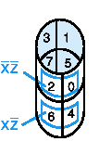
Three-Variable Map
yz
00
01
11
10
x
0
m₀
m₁
m₃
m₂
0
1
3
2
1
m₄
m₅
m₇
m₆
4
5
7
6
-Note: variable ordering is (x,y,z); yz specifies column, x specifies row.
-Each cell is adjacent to three other cells (left or right or top or bottom or edge wrap)

Slide 97
Three-variable Map Simplification
One square(uncombined) represents a minterm of 3 literals.
A rectangle of 2 adjacent squares represents a product term of 2 literals.
A rectangle of 4 squares represents a product term of 1 literal.
A rectangle of 8 squares represents a functional value equal to 1.(F=1)

Slide 98
Three-Variable Map (cont.)
minterm
The types of structures that are either minterms or are generated by repeated application of the minimization theorem on a three variable map are shown at right. Groups of 1, 2, 4, 8 are possible.
group of 2 terms
group of 4 terms

Slide 99
Three-Variable Map
There is only one possibility of grouping 8 adjacent min terms.
The possible combinations of grouping 4 adjacent min terms are {(m0, m1, m3, m2), (m4, m5, m7, m6), (m0, m1, m4, m5), (m1, m3, m5, m7), (m3, m2, m7, m6) and (m2, m0, m6, m4)}.
The possible combinations of grouping 2 adjacent min terms are {(m0, m1), (m1, m3), (m3, m2), (m2, m0), (m4, m5), (m5, m7), (m7, m6), (m6, m4), (m0, m4), (m1, m5), (m3, m7) and (m2, m6)}.
If x=0, then 3 variable K-map becomes 2 variable K-map.

Slide 100
Simplification
Enter minterms of the Boolean function into the map, then group terms
Example: f(a,b,c) = a’c + abc + bc’
Result: f(a,b,c) = a’c+ b
bc
a
 | 1 | 1 | 1
 |  | 1 | 1
 | 1 | 1 | 1
 |  | 1 | 1

Slide 101
More Examples
yz X | 00 | 01 | 11 | 10
0 |  |  | 1 | 1
1 |  | 1 | 1
f₁(x, y, z) = ∑ m(2,3,5,7)
f₂(x, y, z) = ∑ m (0,1,2,3,6)
f₁(x, y, z) = x’y + xz
1 | 1 | 1 | 1
 |  |  | 1
f₂(x, y, z) = x’+yz’

Slide 102
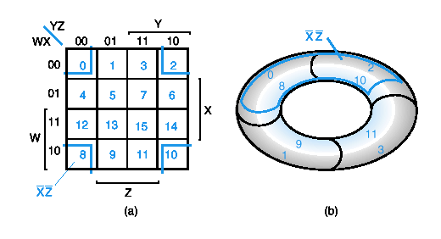
Four-Variable Maps
YZ
00
01
11
10
_{WX}
00
m₀
m₁
m₃
m₂
01
m₄
m₅
m₇
m₆
11
m₁₂
m₁₃
m₁₅
m₁₄
10
m₈
m₉
m₁₁
m₁₀
Top cells are adjacent to bottom cells. Left-edge cells are adjacent to right-edge cells.
Note variable ordering (WXYZ).

Slide 103
Four-variable Map Simplification
One square represents a minterm of 4 literals.
A rectangle of 2 adjacent squares represents a product term of 3 literals.
A rectangle of 4 squares represents a product term of 2 literals.
A rectangle of 8 squares represents a product term of 1 literal.
A rectangle of 16 squares produces a function that is equal to logic 1.

Slide 104
Example
Simplify the following Boolean function (A,B,C,D) = ∑m(0,1,2,4,5,7,8,9,10,12,13).
First put the function g( ) into the map, and then group as many 1s as possible.
ab
_{cd}
1
1
1
1
1
1
1
1
1
1
1
1
1
1
1
1
1
1
1
1
1
1
g(A,B,C,D) = c’+b’d’+a’bd

